Slide 1
CS4225/CS5425 Big Data Systems for Data Science
Tutorial 3 Answers
Desmond Lau
School of Computing
National University of Singapore
dlau@nus.edu.sg

Slide 2
Question 1
In Spark Structured Streaming, why do we need to specify a checkpoint location?
To save the progress information of a stream query, i.e. what data has been successfully processed. Upon failure, this info is used to restart the failed query exactly where it left off.

Slide 3
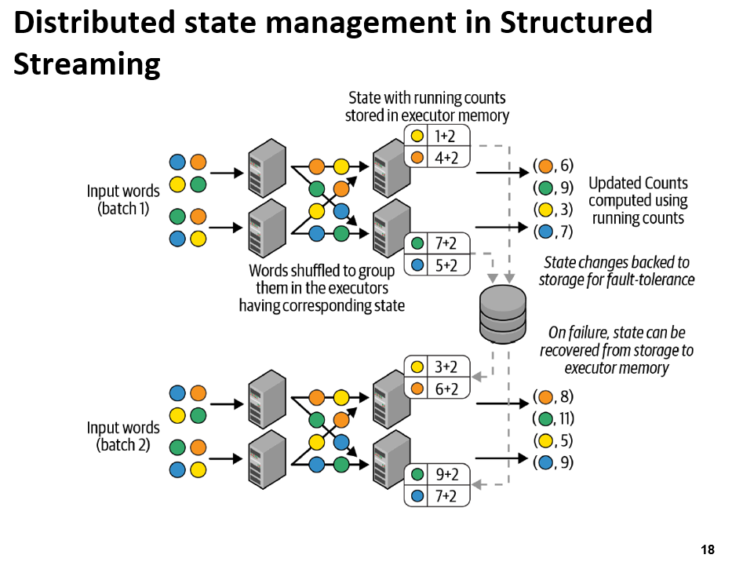
Each micro-batch
Reads a new set of words
Shuffles them within the executors to group them
Computes the counts within the micro-batch
Adds them to the running counts to produce the new counts, which are simultaneously
  Output
  State for the next micro-batch
  Cached in the memory of the executors
  Synchronously saved in the checkpoint location provided by the user
Lecture 9: Slide 18

Slide 4
Question 2
Flink’s event time processing is made possible by watermarks, which indicate the progress of event time in the stream. True or False?
True. Watermarks in Flink are special records that indicate the progress of event time. They help the system understand when it can trigger event time-based operations, such as window functions, etc.

Slide 5
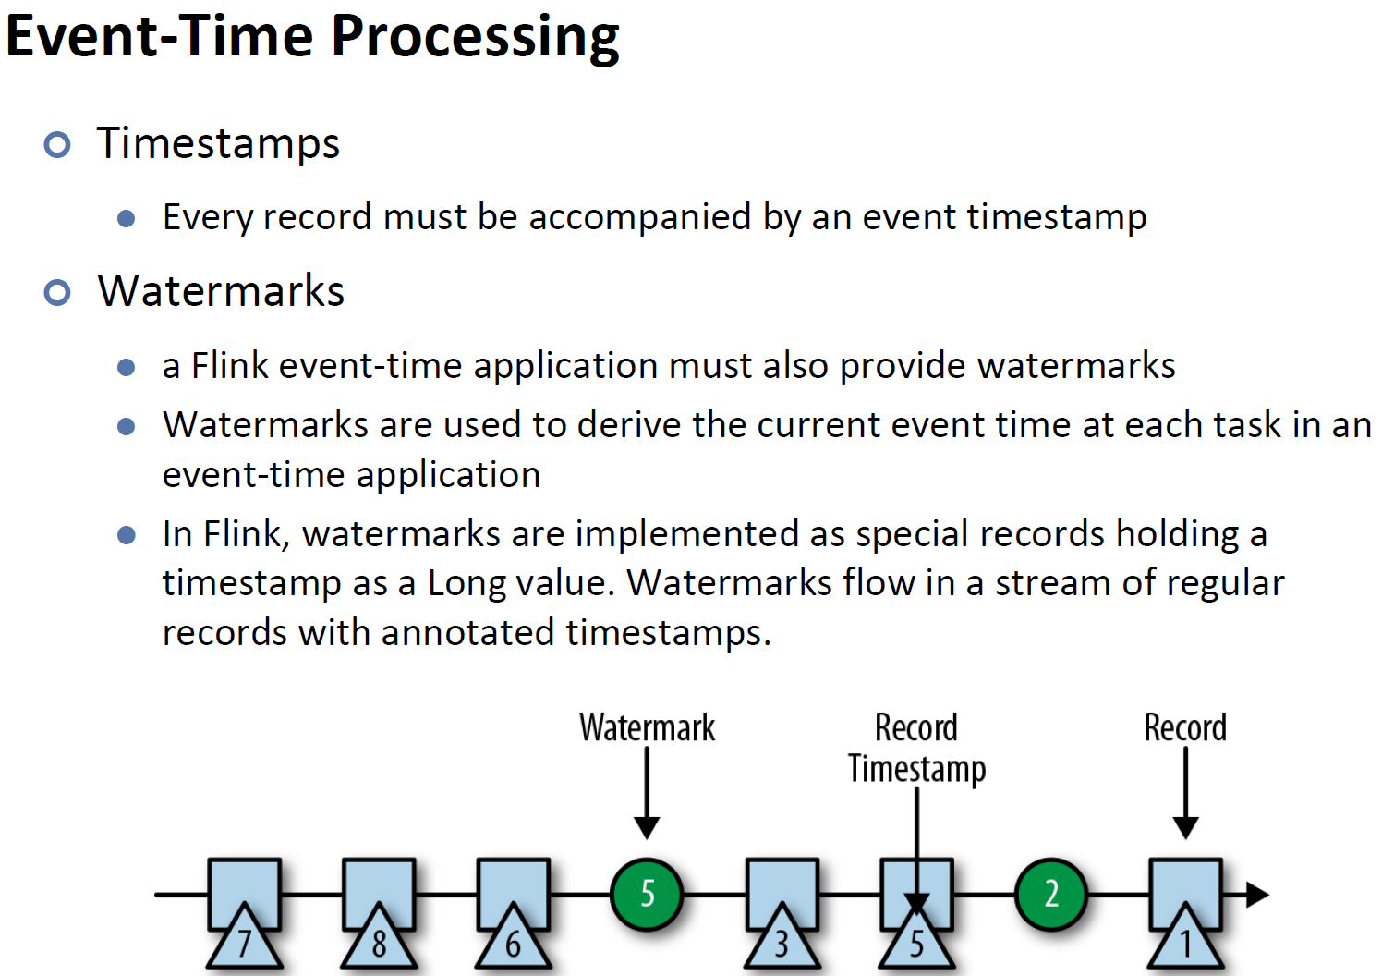
Lecture 9: Slide 39

Slide 6
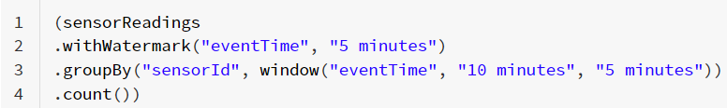
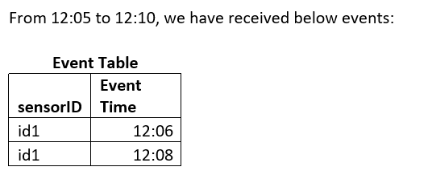
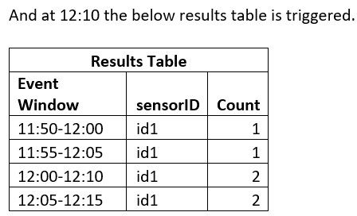
Question 3
In Spark Structured Streaming, we are using the code below to collect the streaming data from sensor readings.

Slide 7
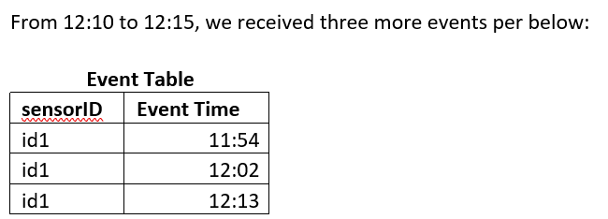
Question 3
In Spark Structured Streaming, we are using the code below to collect the streaming data from sensor readings.

Slide 8
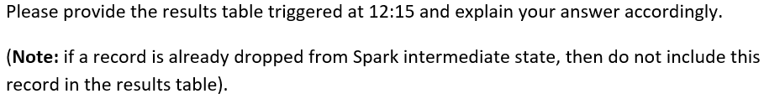
Question 3
In Spark Structured Streaming, we are using the code below to collect the streaming data from sensor readings.

Slide 9
From 12:05 – 12:10
Result Table (12:10)
SensorID | Event Time
Id1 | 12:06
Id1 | 12:08
Event Window | SensorID | Count
11:50-12:00 | id1 | 1
11:55-12:05 | id1 | 1
12:00-12:10 | Id1 | 2
12:05-12:15 | id1 | 2
From earlier processing time
12:20
12:15
12:10
12:05
12:00
11:55
11:50
Event Time
12:08
12:08 – 5min
12:06
WM: 12:03
11:50 11:55 12:00 12:05 12:10 12:15 12:20
Processing Time with 5 min trigger

Slide 10
From 12:05 – 12:10
From 12:10 – 12:15
Result Table (12:15)
SensorID | Event Time
Id1 | 12:06
Id1 | 12:08
SensorID | Event Time
Id1 | 11:54
Id1 | 12:02
Id1 | 12:13
Event Window | SensorID | Count
11:50-12:00 | id1 | 1
11:55-12:05 | id1 | 1
12:00-12:10 | id1 | 2
12:05-12:15 | id1 | 2
12:10-12:20
2
3
3
id1
1
12:20
12:15
12:10
12:05
12:00
11:55
11:50
Event Time
12:13
12:13 – 5min
WM: 12:08
12:08
12:08 – 5min
12:06
WM: 12:03
12:02
11:54
11:54
11:50 11:55 12:00 12:05 12:10 12:15 12:20
Processing Time with 5 min trigger

Slide 11
From 12:05 – 12:10
From 12:10 – 12:15
Result Table (12:15)
SensorID | Event Time
Id1 | 12:06
Id1 | 12:08
SensorID | Event Time
Id1 | 11:54
Id1 | 12:02
Id1 | 12:13
Event Window | SensorID | Count
11:55-12:05 | Id1 | 2
12:00-12:10 | Id1 | 3
12:05-12:15 | Id1 | 3
12:10-12:20 | id1 | 1
12:20
12:15
12:10
12:05
12:00
11:55
11:50
Event Time
12:13
12:13 – 5min
WM: 12:08
12:08
12:08 – 5min
12:06
WM: 12:03
12:02
11:54
11:54
11:50 11:55 12:00 12:05 12:10 12:15 12:20
Processing Time with 5 min trigger

Slide 12
Question 3
Result Table (12:15)
Event Window | SensorID | Count
11:55-12:05 | Id1 | 2
12:00-12:10 | Id1 | 3
12:05-12:15 | Id1 | 3
12:10-12:20 | id1 | 1
Watermark = max event time (before 12:10) – watermark delay = 12:08 – 5 min = 12:03
Therefore, intermediate state for 11:50-12:00 is dropped as watermark (12:03) > 12:00. The 11:50-12:00 entry will not be updated, and the rest entries are updated accordingly.
Note: the intermediate state 11:55-12:05 is NOT dropped as watermark (12:03) < 12:05, there may still be events from 12:03 to 12:05 that need to be recorded.

